Slide 1
Decision Trees (and More)
Tree-based methods for classification and regression.
Sean Kang

Slide 2
Decision Trees and Overfitting

Slide 3
Overfitting and Decision Trees
Running the training data on the decision tree, we can always get 100% accuracy. This should give us concern about possible overfitting.
Decision tree can easily get overfitted.
The decision tree can get 100% accuracy on the training data.
But it can perform poorly on unseen test data.

Slide 4
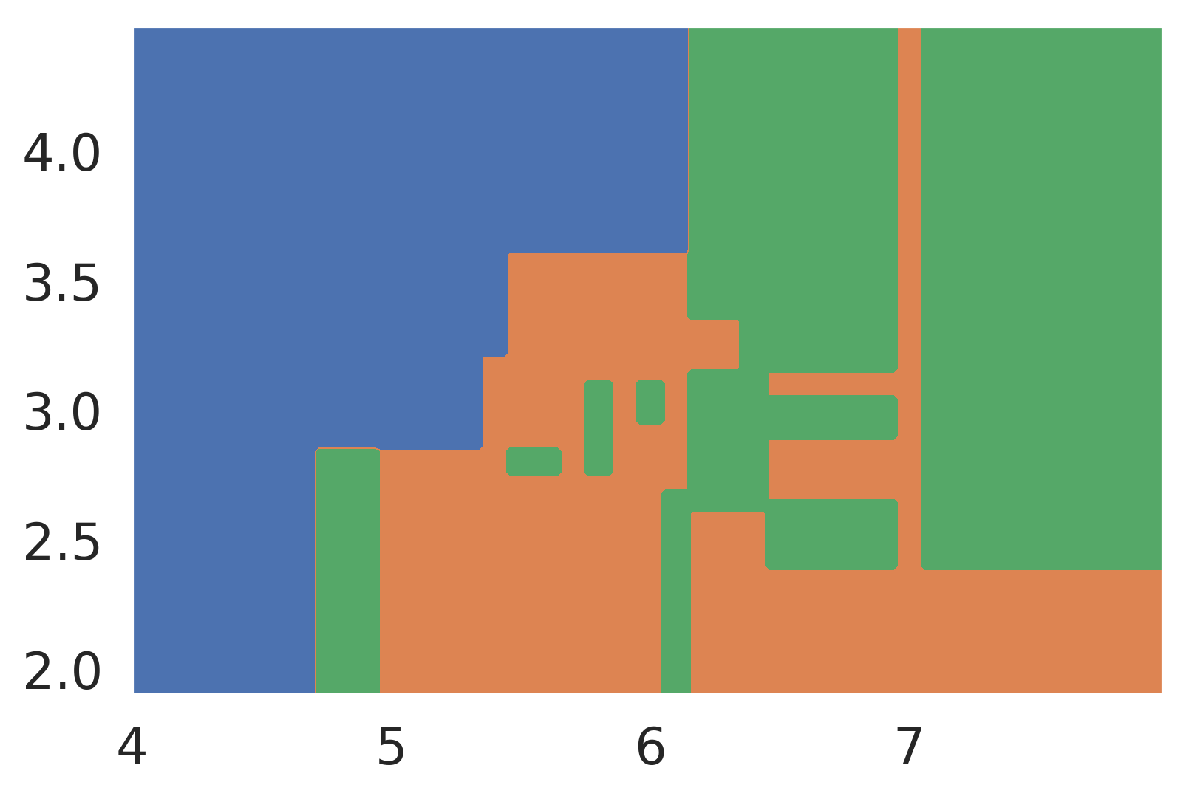
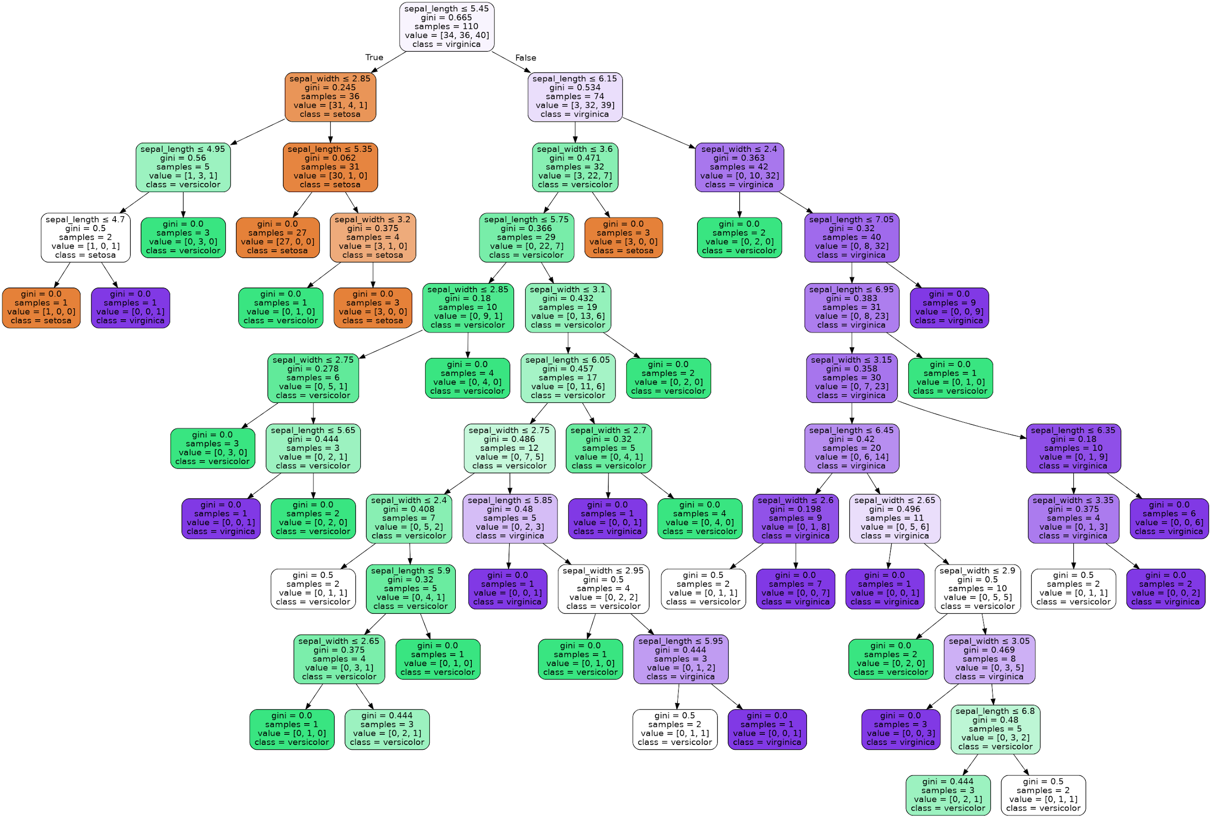
Overfitting Visualized
The decision boundaries for our sepal model were quite complex
Or drawn out as a tree, we also see a highly complex structure
Next, we’ll discuss strategies for preventing overfitting
Model 2D-Sepal-110

Slide 5
Technique to avoid overfitting on trees
Pruning
Pre-pruning
Post-pruning
Ensemble – a new idea of doing it
Random Forest

Slide 6
Restricting Decision Tree Complexity or Remove Overfitting

Slide 7
Overfitting and Our Algorithm
A “fully grown” decision tree built with our algorithm runs the risk of overfitting
One idea to avoid overfitting: Don’t allow fully grown trees. By default, a decision tree grows to its full height.
Model 2D-Sepal-110

Slide 8
Approach 1: Preventing Growth (pre)
Approach 1: Set one or more special rules to prevent growth
Don’t let a node get split from an outlier or a few data records
Don’t allow the tree height to get too tall
Examples:
Don’t split nodes with < 1% of the samples
Don’t allow nodes to be more than 7 levels deep in the tree

Slide 9
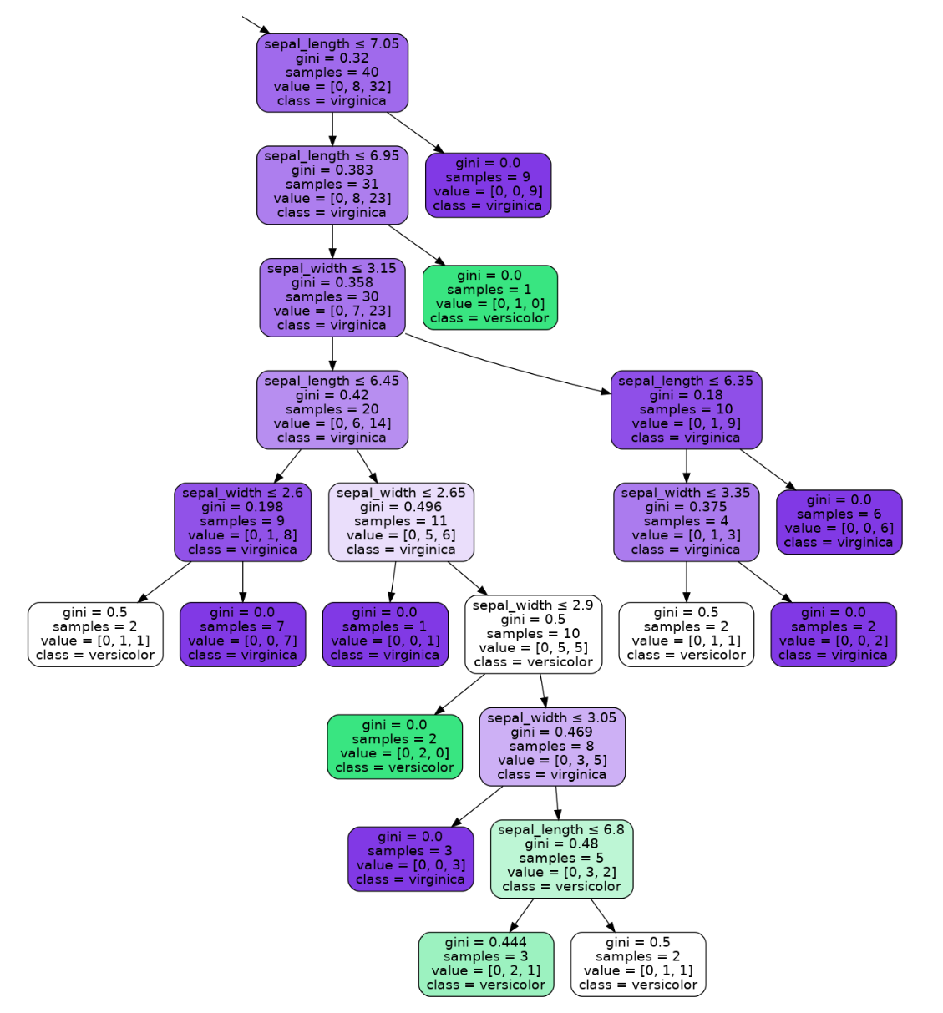
Approach 2: Pruning (post)
Approach 2: Let tree fully grow, then cut off less useful branches of the tree. For example, consider the highlighted branch below:
Many rules that affect few points
How can we avoid this?

Slide 10
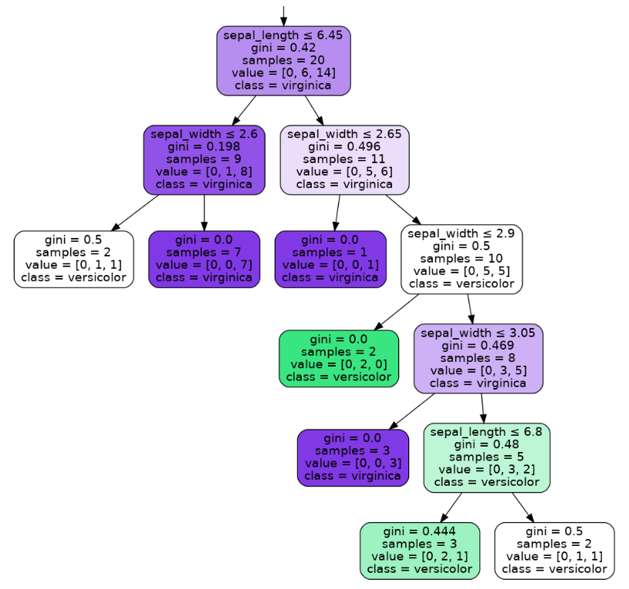
Specific Pruning Example
One way to prune:
Before creating the tree, set aside a validation set
If replacing a node by its most common prediction has no impact on the validation error, then don’t split that node

Slide 11
How to Interpret the Post-Pruning
The best AUC ROC score should be the highest..
The corresponding cch-alpha is the optimal value for post-pruning.
Notes:
https://scikit-learn.org/stable/modules/generated/sklearn.metrics.roc_auc_score.html

Slide 12
Summary of Pruning: Overfitting and Our Algorithm
A “fully grown” decision tree built with our algorithm runs the risk of overfitting
One idea to avoid overfitting: Don’t allow fully grown trees
Approach 1: Set rules to prevent full growth
Approach 2: Allow full growth then prune branches afterwards
Won’t discuss these in any great detail
There’s a completely different idea called a “random forest” that is more popular and more beautiful
Model 2D-Sepal-110

Slide 13
Another Approach: Random Forests

Slide 14
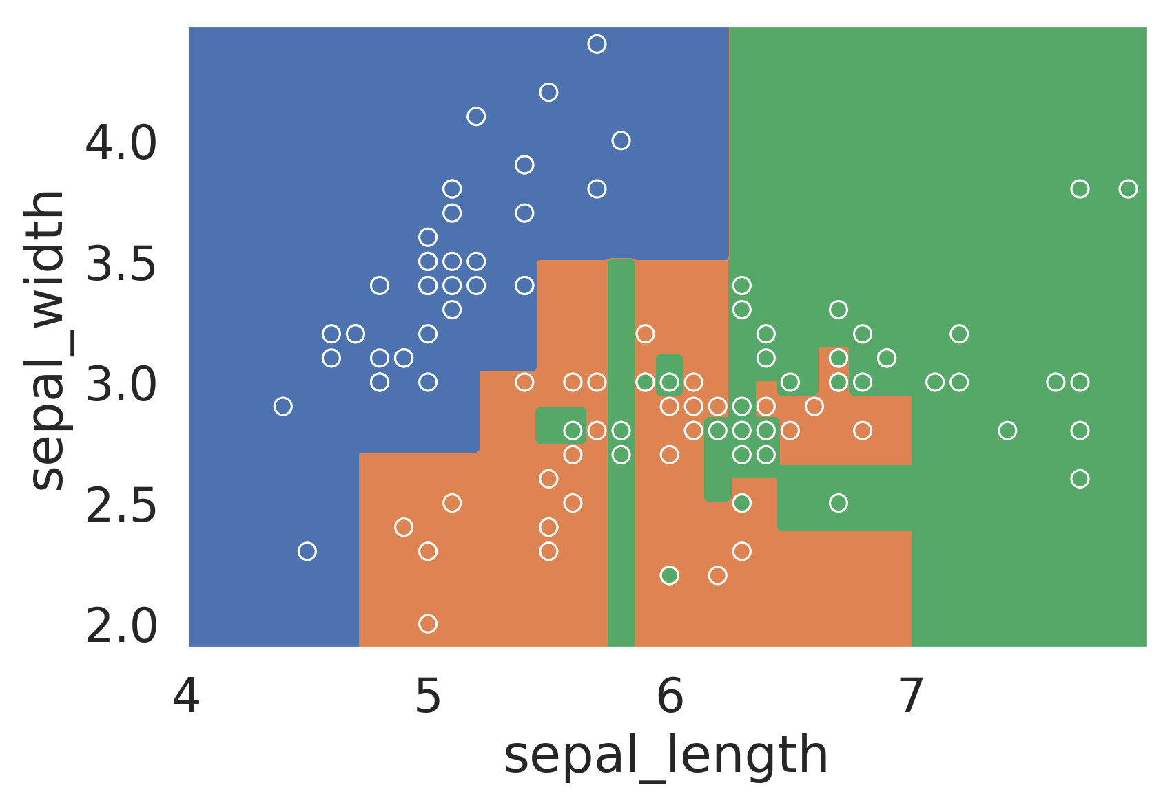
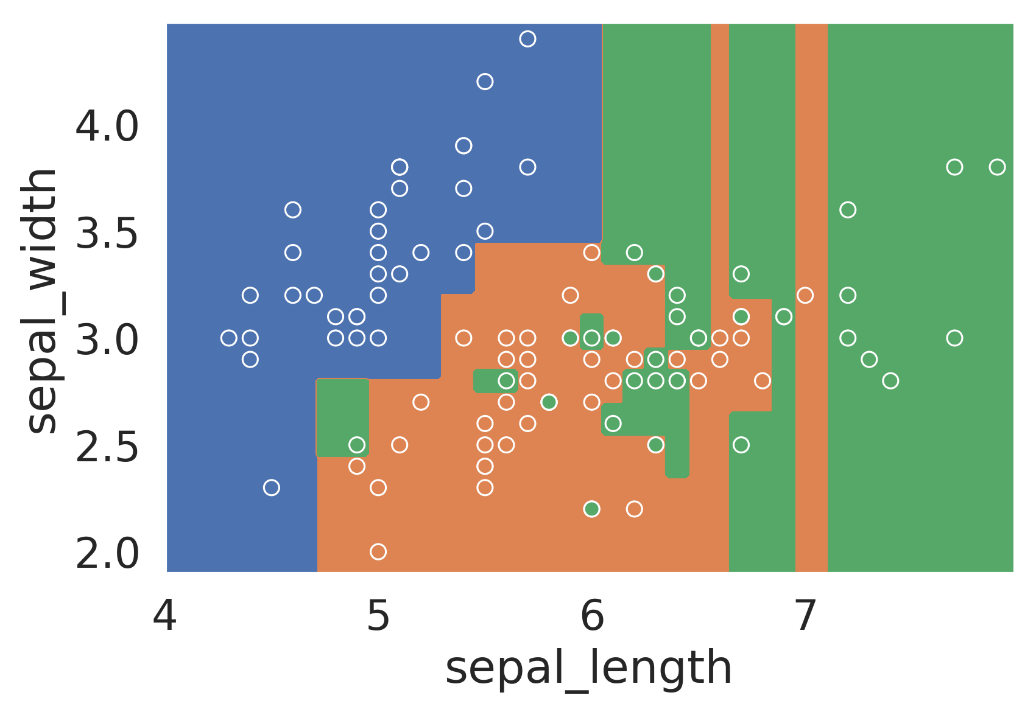
Random Forests: Harnessing Variance
Model 2D-Sepal-110-A
As we’ve seen, fully-grown decision trees will almost always overfit data
Low model bias, high model variance
In other words, small changes in dataset will result in very different decision tree
Example: Two models on the right trained on different subsets of the same data
Random Forest Idea: Build many decision trees and have them vote
Model 2D-Sepal-110-B
Model 2D-Sepal-110-A

Slide 15
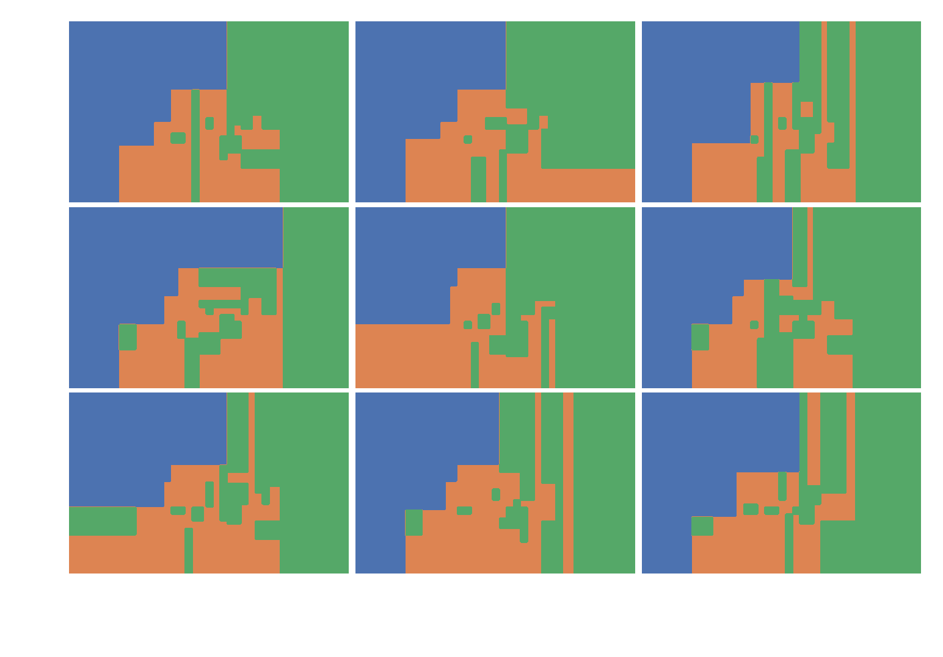
Random Forests: Harnessing Variance
What do we mean by vote?
For a given x/y, use whichever prediction is most popular
Consider example at right with 9 models
6 votes orange, 3 votes green
Random forest prediction is orange
Point we want to predict.
Model 2D-Sepal-110-A

Slide 16
Building Many Trees
Big fundamental problem: We only have one training set.
How can we build many trees using one training set?

Slide 17
Bagging
Bagging: Short for Bootstrap AGGregatING
Generate bootstrap resamples of training data (draw samples with replacements)
Fit one model for each resample
Final model = average predictions of each small model

Slide 18
Random Forests
Bagging often isn’t enough to reduce model variance!
Decision trees often look very similar to each other
E.g., one strong feature always used for first split

Slide 19
Random Forests
Bagging often isn’t enough to reduce model variance!
Decision trees often look very similar to each other and thus make similar predictions
Ensemble will still have low bias and high model variance
E.g. one strong feature always used for first split
Idea: Only use a sample of m features at each split
Algorithm creates individual trees, each overfit in a different way
The hope is that the the overall forest has low variance

Slide 20
Random Forests Algorithm
Bootstrap training data T times. For each resample, fit a decision tree
To predict, ask the T decision trees for their predictions and take majority vote
This approach has two hyperparameters T and m, where m is the number of features selected randomly for each split

Slide 21
Avoiding Overfitting with Heuristics
We’ve seen many approaches to avoid overfitting decision trees
Preventing growth
Pruning
Random forests
These ideas are generally “heuristic”
Not probably best or mathematically optimal
Instead, they are just ideas that somebody thought sounded good, implemented, then found to work in practice acceptably well. LOL

Slide 22
Why Random Forests?
Versatile: does both regression and classification
Nonlinear decision boundaries without complicated feature engineering
Doesn’t overfit as often as other nonlinear models (e.g. polynomial features)

Slide 23
Beyond Decision Trees for Classification

Slide 24
Trees for Regression
In earlier lectures we saw how we could use a logistic regression model for classification
This lecture: We saw decision trees as an alternative technique for classification
We could do the same exercise for regression
Rather than using a linear model, we could build a regression tree
Does the person have prior experience?
Yes
No
How many years?
$15/hour
< 2
2-5
>5
$18/hour
$20/hour
Are they a manager?
no
yes
$22/hour
$27/hour

Slide 25
Summary
Decision trees provide an alternate non-linear framework for classification and regression
The underlying principle is fundamentally different
Decision boundaries can be more complex
Danger of overfitting is high
Keeping complexity under control is not nearly as mathematically elegant and relies on heuristic rules
Hard constraints
Pruning rules
Random forests
Very interesting application of bootstrapping

Slide 26
Summary
In practice, you will see that there are actually even more conceptual frameworks for regression and classification:
Linear models
Decision trees
Nearest neighbors
Support vector machines.
Bayes Nets
Perceptrons
Neural networks / deep learning
And many many many many more
Machine learning classes will go over these ideas in more detail
How they work (and the tradeoffs for using them) are beyond our class

